Slide 1
Introduction:
​The "Gesture-to-Text and Speech System" is a smart tool that helps people who use sign language talk to those who don’t understand it. It uses powerful technology like AI (Artificial Intelligence), computer vision (which helps the system see and understand hand movements), and wearable devices to turn sign language into text and spoken words instantly. This makes communication easier and more inclusive in places like schools, hospitals, offices, and public areas.

Slide 2
Objectives of the Invention:
Accurately recognize sign language movements using a camera Translate hand movements into text and spoken language in real-time.
Example: If someone signs "Hello," the system will immediately say "Hello" out loud or show it as text on the screen.
The system would enhance the accessibility of deaf and hard-of-hearing people to communicate easily in different environments.
Provide a user-friendly and portable tool for daily communication.

Slide 3
Algorithms Commonly Used in Gesture Recognition Systems:
Hand Detection and Tracking:
Algorithm: MediaPipe Hands
2. Feature Extraction:
Algorithm: CNN (Convolutional Neural Network)
3. Text-to-Speech (TTS) Conversion:
pyttsx3 library

Slide 4
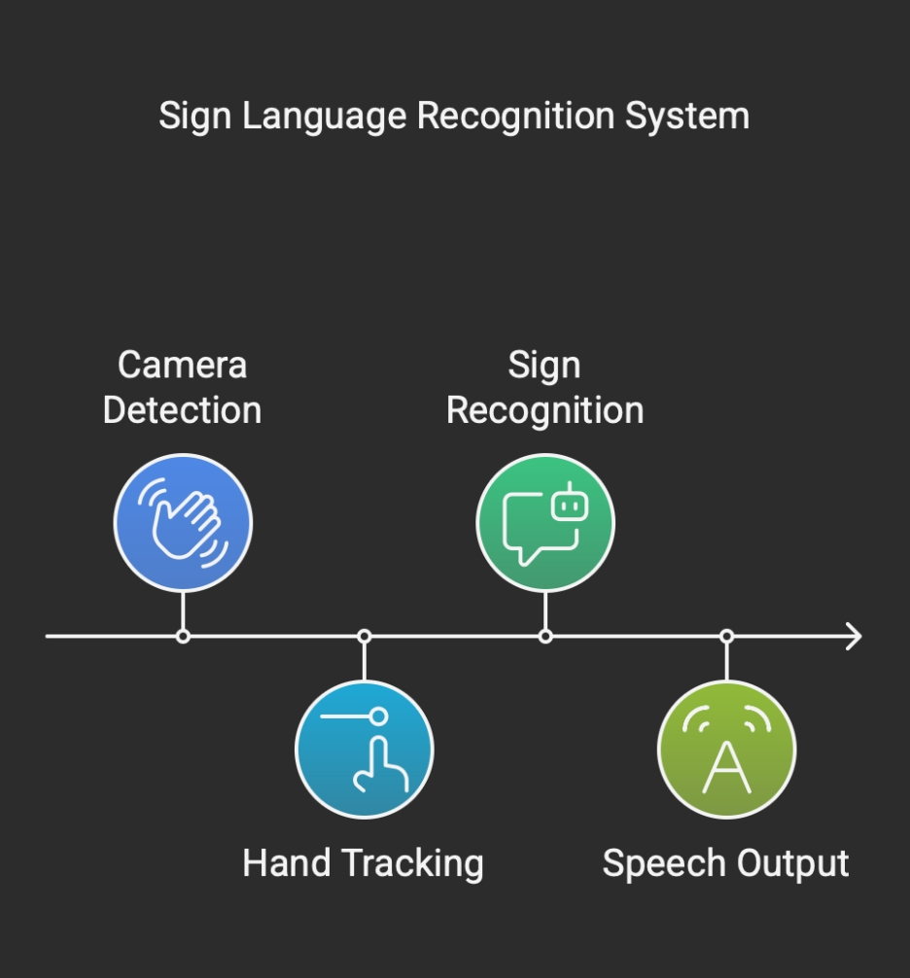

Slide 5
Scalability and Future Growth:
Scale the system to incorporate full words and sentences as well as individual letters.
Improve AI models to recognize multiple sign languages (ASL, BSL, ISL, etc.).
Develop it into a compatible form for Augmented Reality (AR) and Virtual Reality (VR) hardware for greater access.

Slide 6
Flaws or Limitations of the System:
The system may get confused with similar or complicated gestures.
There could be a small delay while converting gestures to text or speech.
A camera or wearable device is required to detect gestures.
Movements or noise in the background might affect gesture detection.

